Slide 1
Chapter 11:
Inheritance and Composition

Slide 2
Objectives
In this chapter, you will:
  Learn about inheritance
  Learn about derived and base classes
  Learn accessing protected members in the derived class
  Learn about order of construction and destruction
  Learn about dominating base class members in derived class
C++ Programming: From Problem Analysis to Program Design, Seventh Edition

Slide 3
Objectives (cont’d.)
  Learn about overriding base class member functions in a derived class
  Learn about using derived class object as a base class object
  Learn about using derived class pointers as base class pointers
  Explore three types of inheritance: public, protected, and private
  Become familiar with the three basic principles of object-oriented design
C++ Programming: From Problem Analysis to Program Design, Seventh Edition

Slide 4
Inheritance
Inheritance: “is-a” relationship
  Example: “every employee is a person”
Inheritance allows creation of new classes from existing classes
  Derived classes: new classes created from the existing class
  Base class: the original class
Derived class inherits data members and member functions of its base classes
C++ Programming: From Problem Analysis to Program Design, Seventh Edition

Slide 5
Inheritance (cont’d.)
Inheritance helps reduce software complexity
Single inheritance: derived class has a single base class
Multiple inheritance: derived class has more than one base class
C++ Programming: From Problem Analysis to Program Design, Seventh Edition

Slide 6
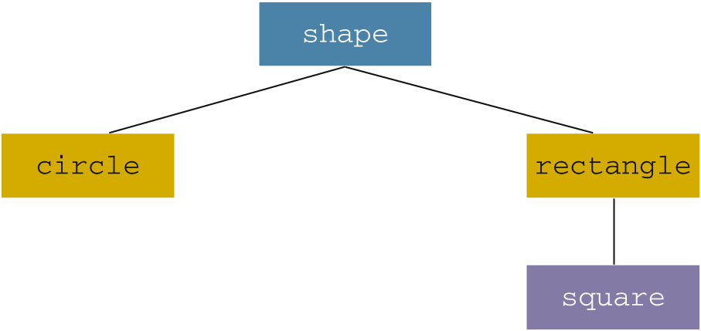
Inheritance (cont’d.)
Inheritance can be viewed as a tree-like, or hierarchical, structure between the base class and its derived classes
C++ Programming: From Problem Analysis to Program Design, Seventh Edition

Slide 7
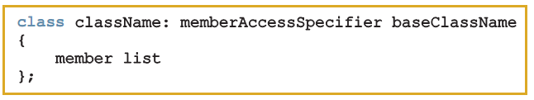
Inheritance (cont’d.)
Syntax of a derived class:
  memberAccessSpecifier is public, protected, or private (default)
private members of a base class are private to the base class
  Derived class cannot directly access them
C++ Programming: From Problem Analysis to Program Design, Seventh Edition

Slide 8
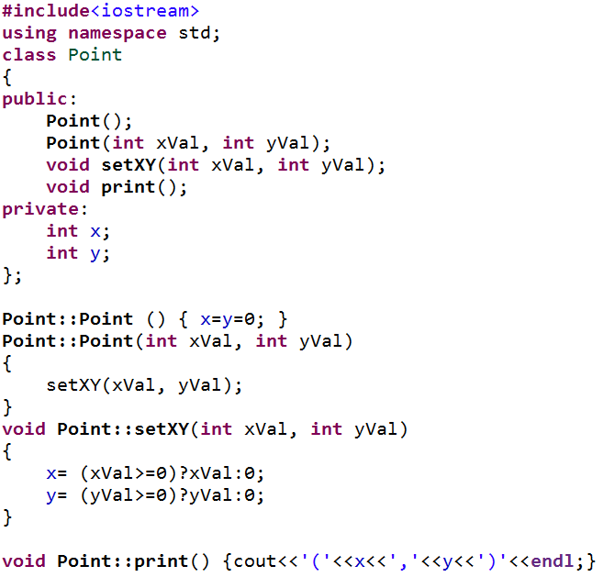
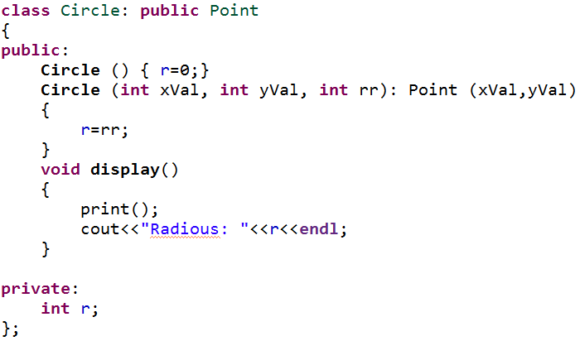

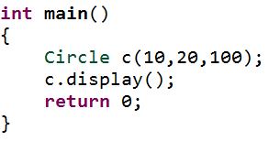
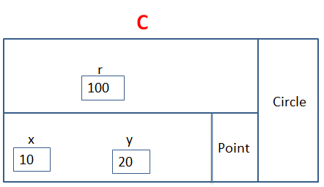
Inheritance (cont’d.)
OUTPUT
C++ Programming: From Problem Analysis to Program Design, Seventh Edition

Slide 9
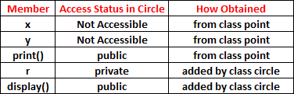
Inheritance (cont’d.)
All member variables and functions of the base class are also member variables and functions of the derived class
Derived class can include additional members (data and/or functions)
C++ Programming: From Problem Analysis to Program Design, Seventh Edition

Slide 10
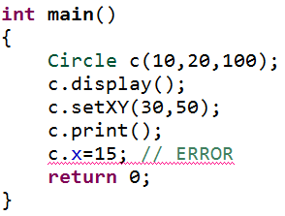
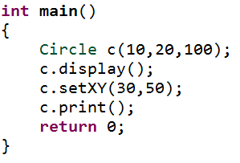
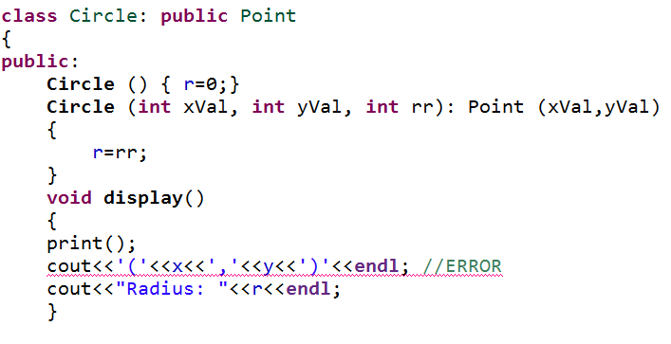

Inheritance (cont’d.)
OUTPUT
C++ Programming: From Problem Analysis to Program Design, Seventh Edition

Slide 11
Accessing protected members in the derived class
Derived class cannot directly access private members of it base class
  To give it direct access, declare that member as protected
C++ Programming: From Problem Analysis to Program Design, Seventh Edition

Slide 12
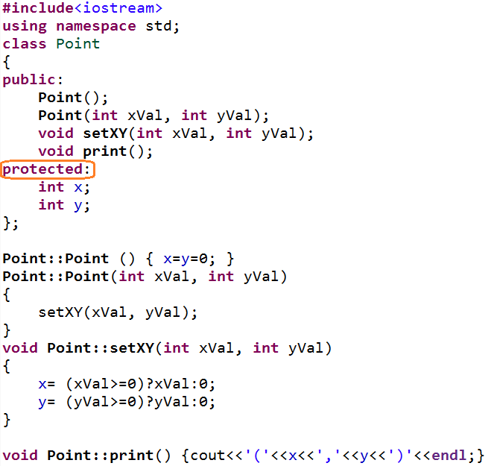
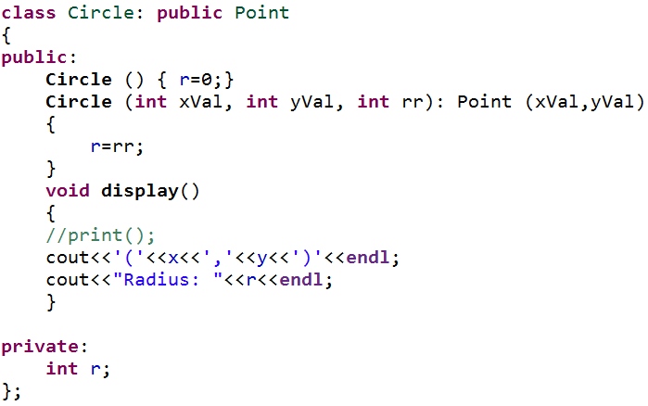
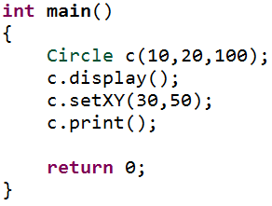

Accessing protected members in the derived class (cont’d.)
OUTPUT
C++ Programming: From Problem Analysis to Program Design, Seventh Edition

Slide 13
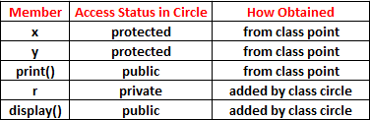
Accessing protected members in the derived class (cont’d.)
Access Status of Circle’s Members
C++ Programming: From Problem Analysis to Program Design, Seventh Edition

Slide 14
Order of Construction and Destruction
When you create an instance of a derived class the compiler calls constructors in the following orders:
  The constructor of the base class
  The constructor for any member objects (composition)
  The constructor of the derived class
Destructors are called in the exact opposite order of construction order (3,2,1)
C++ Programming: From Problem Analysis to Program Design, Seventh Edition

Slide 15
Dominating Base Class Members in Derived Class
There are two forms for dominating:
Dominating base class data members in a derived class
  If a derived class adds a data member with the same name as a data member in the base class, the derived class hides the inherited data member.
Dominating bass class member functions in a derived class
  A derived class can hides an inherited base class function by supplying a new version of the function with the same name but with different parameters list (overloading)
C++ Programming: From Problem Analysis to Program Design, Seventh Edition

Slide 16
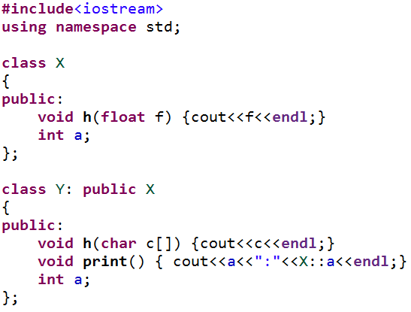
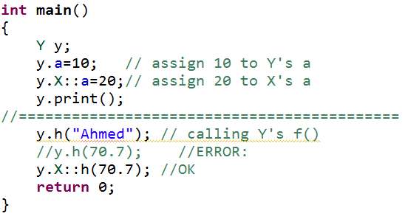

Dominating Base Class Members in Derived Class (cont’d.)
OUTPUT
C++ Programming: From Problem Analysis to Program Design, Seventh Edition

Slide 17
Redefining (Overriding) Member Functions of the Base Class
To redefine a public member function:
  Corresponding function in derived class must have same name/number/types of parameters
If derived class overrides a public member function of the base class, then to call the base class function, specify:
  Name of the base class
  Scope resolution operator (::)
  Function name with appropriate parameter list
C++ Programming: From Problem Analysis to Program Design, Seventh Edition

Slide 18
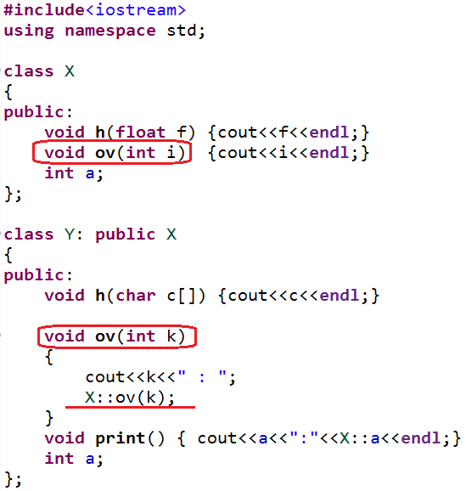
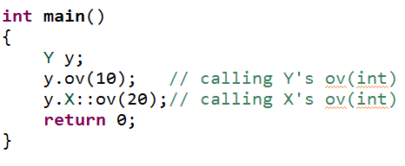

Redefining (Overriding) Member Functions of the Base Class (cont’d.)
OUTPUT
C++ Programming: From Problem Analysis to Program Design, Seventh Edition

Slide 19

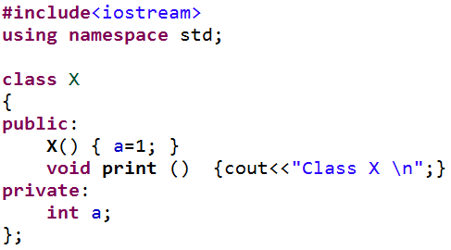
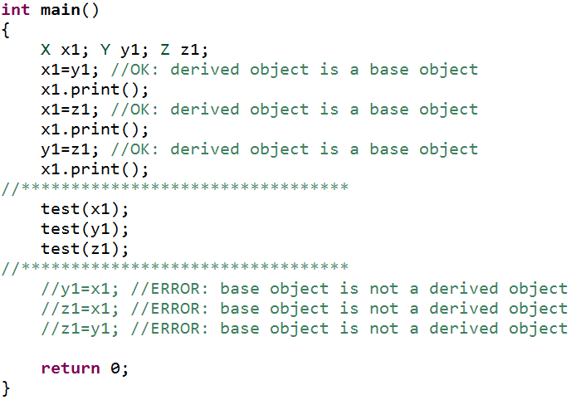

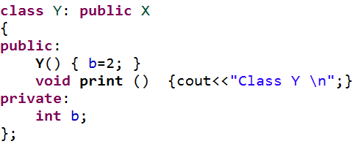
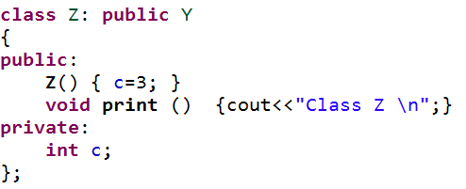
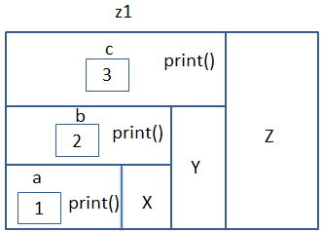
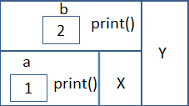
A Derived Class Object as a Base Class Object
OUTPUT
x1
y1
C++ Programming: From Problem Analysis to Program Design, Seventh Edition

Slide 20
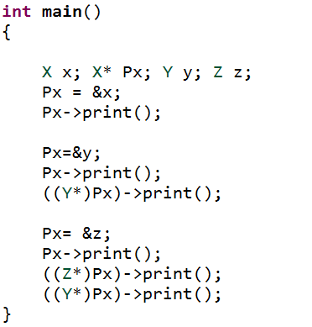
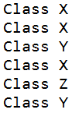
A Derived Class Pointer as a Base Class Pointer
OUTPUT
C++ Programming: From Problem Analysis to Program Design, Seventh Edition

Slide 21
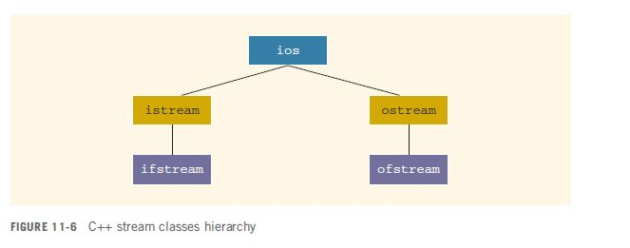
C++ Stream Classes
ios is the base class for all stream classes
  Contains formatting flags and member functions to access/modify the flag settings
C++ Programming: From Problem Analysis to Program Design, Seventh Edition

Slide 22
C++ Stream Classes (cont’d.)
istream and ostream provide operations for data transfer between memory and devices
  istream defines the extraction operator (>>) and functions get and ignore
  ostream defines the insertion operator (<<) which is used by cout
ifstream/ofstream objects are for file I/O
  Header file fstream contains the definitions for these
C++ Programming: From Problem Analysis to Program Design, Seventh Edition

Slide 23
Inheritance as public, protected, or private
Assume class B is derived from class A with
If memberAccessSpecifier is public:
  public members of A are public in B, and can be directly accessed in class B
  protected members of A are protected in B, and can be directly accessed by member functions (and friend functions) of B
  private members of A are hidden in B and can be accessed only through public or protected members of A
C++ Programming: From Problem Analysis to Program Design, Seventh Edition

Slide 24
Inheritance as public, protected, or private (cont’d.)
If memberAccessSpecifier is protected:
  public members of A are protected members of B and can be accessed by the member functions (and friend functions) of B
  protected members of A are protected members of B and can be accessed by the member functions (and friend functions) of B
  private members of A are hidden in B and can be accessed only through public or protected members of A
C++ Programming: From Problem Analysis to Program Design, Seventh Edition

Slide 25
Inheritance as public, protected, or private (cont’d.)
If memberAccessSpecifier is private:
  public members of A are private members of B and can be accessed by member functions of B
  protected members of A are private members of B and can be accessed by member functions (and friend functions) of B
  private members of A are hidden in B and can be accessed only through public/protected members of A
C++ Programming: From Problem Analysis to Program Design, Seventh Edition

Slide 26
Object-Oriented Design (OOD) and Object-Oriented Programming (OOP)
The fundamental principles of object-oriented design (OOD) are:
  Encapsulation: combines data and operations on data in a single unit
  Inheritance: creates new objects (classes) from existing objects (classes)
  Polymorphism: the ability to use the same expression to denote different operations
C++ Programming: From Problem Analysis to Program Design, Seventh Edition

Slide 27
OOD and OOP (cont’d.)
In OOD:
  Object is a fundamental entity
  Debug at the class level
  A program is a collection of interacting objects
OOD encourages code reuse
Object-oriented programming (OOP) implements OOD
C++ Programming: From Problem Analysis to Program Design, Seventh Edition

Slide 28
Identifying Classes, Objects, and Operations
To find classes: begin with a problem description and identify all nouns and verbs
  From the list of nouns choose the classes
  From the list of verbs choose the operations
Suppose we want to write a program that calculates and prints the volume and surface area of a cylinder
C++ Programming: From Problem Analysis to Program Design, Seventh Edition

Slide 29
Identifying Classes, Objects, and Operations (cont’d.)
State this problem as follows:
  Write a program to input the dimensions of a cylinder and calculate and print the surface area and volume
  Nouns are bold and verbs are italic
  From the list of nouns, can visualize a cylinder as a class (cylinderType) from which we can create many cylinder objects of various dimensions
C++ Programming: From Problem Analysis to Program Design, Seventh Edition

Slide 30
Identifying Classes, Objects, and Operations (cont’d.)
These nouns are characteristics of a cylinder, so they will not be classes:
  Dimensions
  Surface area
  Volume
Next, determine three pieces of information about this class:
  Operations that an object can perform
  Operations that can be performed on an object
  Information that an object must maintain
C++ Programming: From Problem Analysis to Program Design, Seventh Edition

Slide 31
Identifying Classes, Objects, and Operations (cont’d.)
From the verbs, list possible operations that an object of that class can perform, or have performed, on itself
  For the cylinderType class:
    Input
    Calculate
    Print
  Dimensions of the cylinder represent the class’s data
C++ Programming: From Problem Analysis to Program Design, Seventh Edition

Slide 32
Identifying Classes, Objects, and Operations (cont’d.)
Identifying classes via nouns and verbs from problem descriptions is not the only technique possible
There are several other OOD techniques in the literature
C++ Programming: From Problem Analysis to Program Design, Seventh Edition

Slide 33
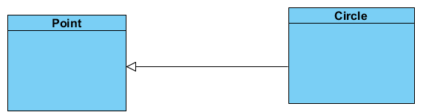
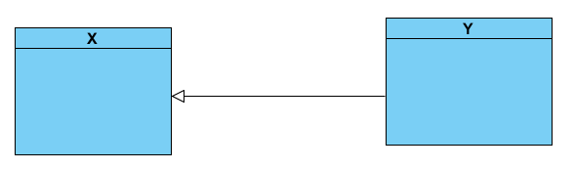
Graphical Representation of Inheritance Relationship
C++ Programming: From Problem Analysis to Program Design, Seventh Edition

Slide 34
Summary
Inheritance and composition are meaningful ways to relate two or more classes
Inheritance is an “is-a” relation
  Single inheritance: a derived class is derived from one class, called the base class
  Multiple inheritance: a derived class is derived from more than one base class
Composition is a “has-a” relation
C++ Programming: From Problem Analysis to Program Design, Seventh Edition

Slide 35
Summary (cont’d.)
Private members of a base class are private to the base class
Public members of a base class can be inherited either as public or private
Derived class can redefine function members of a base class
  Redefinition applies only to objects of derived class
C++ Programming: From Problem Analysis to Program Design, Seventh Edition

Slide 36
Summary (cont’d.)
A call to a base class constructor (with parameters) is specified in the heading of the definition of the derived class constructor
When initializing object of a derived class, the base class constructor is executed first
In composition (aggregation):
  Class member is an object of another class
  Call to constructor of member objects is specified in heading of the definition of class’s constructor
C++ Programming: From Problem Analysis to Program Design, Seventh Edition

Slide 37
Summary (cont’d.)
Three basic principles of OOD:
  Encapsulation
  Inheritance
  Polymorphism
To find classes:
  Describe the problem
  Choose classes from the list of nouns
  Choose operations from the list of verbs
C++ Programming: From Problem Analysis to Program Design, Seventh Edition

Slide 38
Public inheritance: all public members of base class are inherited as public members by derived class
C++ Programming: From Problem Analysis to Program Design, Seventh Edition

Slide 39
THE END
C++ Programming: From Problem Analysis to Program Design, Seventh Edition

